Slide 1


Present by. Nikita lamsoge
COVID-19 IN TODAY'S SOCIETY

Slide 2
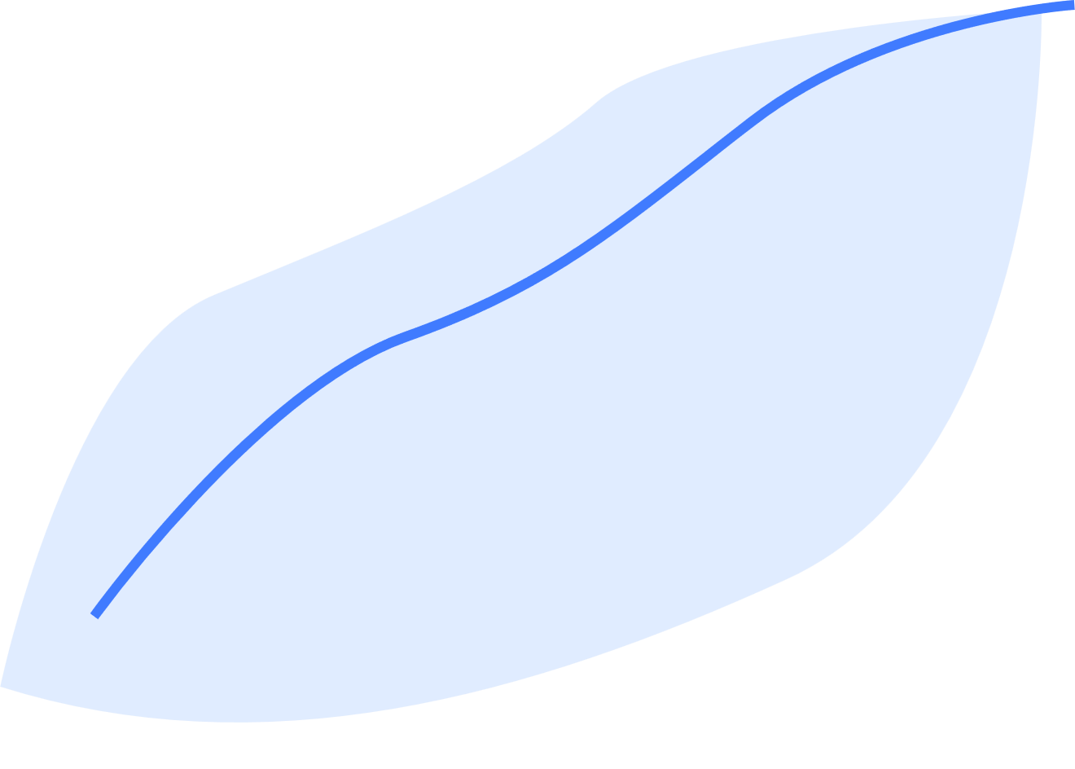

TABLE OF CONTENTS
Presentation Outline
*KPIs*
1.Total Cases and Total Deaths,
2.New Cases and New Deaths per Day,
3.Total Tests and Tests per Million,
4. Total Vaccinations and Vaccination Rate,
5.People Fully Vaccinated and Fully Vaccinated Rate
6. Hospitalization Rate,
7. Case Fatality Rate CFR,
8. Recovery Rate and Death Rate,
9.Testing and Positivity Rate by Age Group,
10.Impact on GD
COVID-19 | 2020

Slide 3


THE BEGINNINGS
Presentation Outline
This KPIs agenda provides a comprehensive snapshot of the COVID-19 pandemic, covering its spread, vaccination efforts, impact on healthcare systems, socio-demographic factors, economic repercussions, geographical variations, and concludes with actionable recommendations based on the data analysis.
COVID-19 | 2020

Slide 4

Keep In Mind:
Pandemic is not a word to use lightly or carelessly. It is a word that, if misused, can cause unreasonable fear, or unjustified acceptance that the fight is over, leading to unnecessary suffering and death.
Dr. Tedros Adhanom, WHO Director General

Slide 5

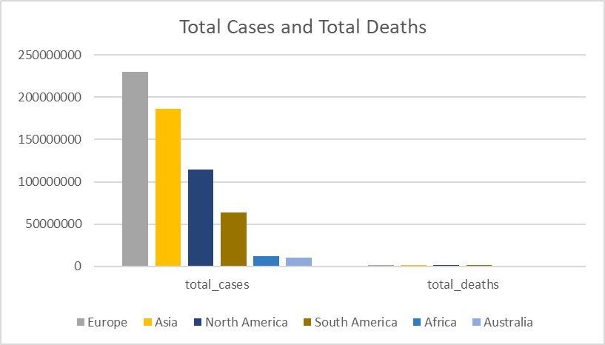
1.Total Number of Cases And Total Number Of Deaths
TOTAL CASES
619712995
TOTAL DEATH
6552099
6552099
.

Slide 6
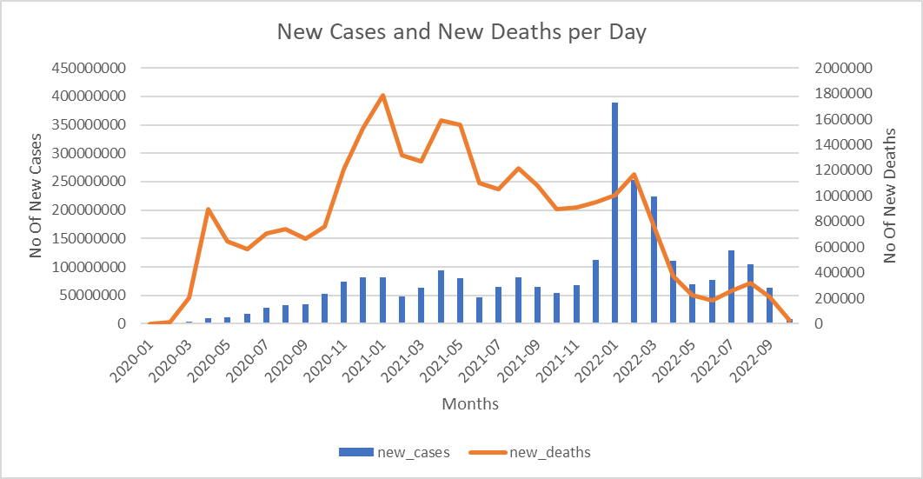
2.New Cases And New Deaths per day

Slide 7
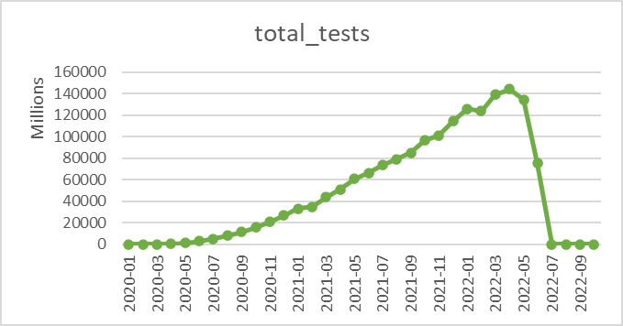
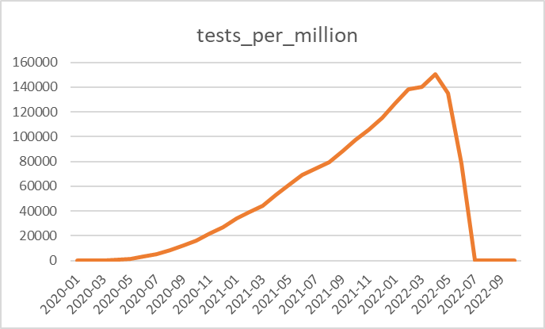
3.Total Test And Test Per Million
This KPI provides an overview of the cumulative number of COVID-19 tests conducted, reflecting the extent of testing efforts to identify and manage cases.
1675428811217 number of tests were conducted overall from
which 2641751351 number of cases has been found to be positive

Slide 8
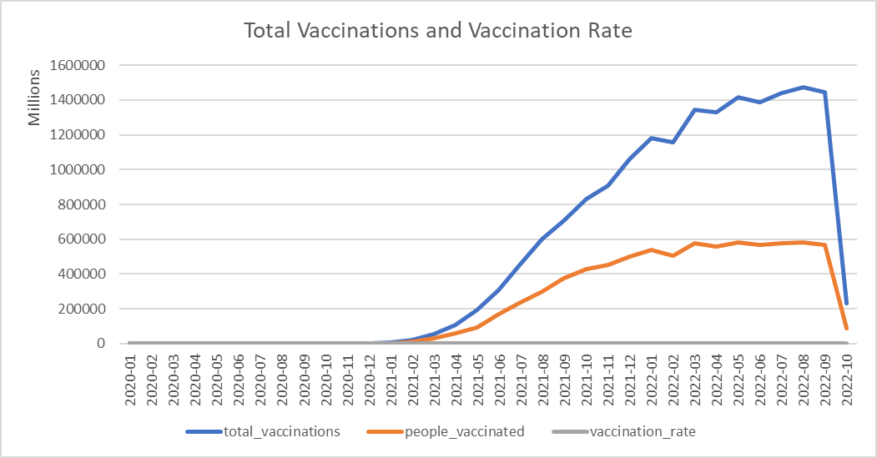
4.Total Vaccinations And Vaccination Rate
17674037830244
number of vaccinations were carried out from 2020-2022

Slide 9
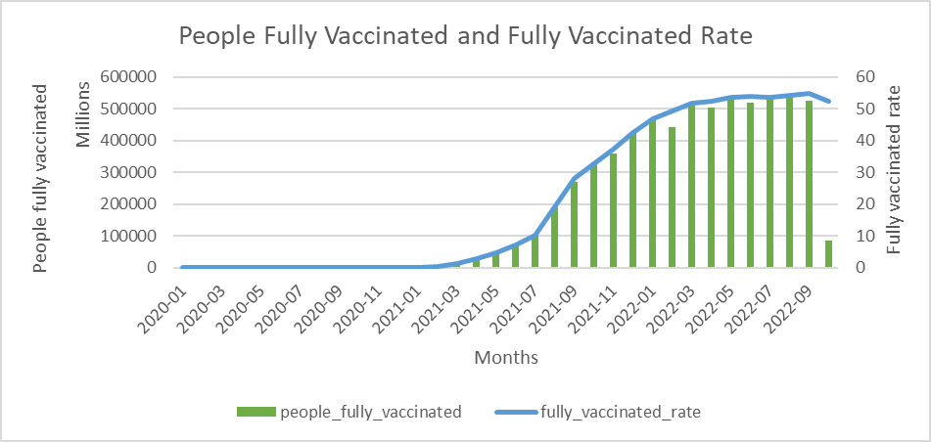
5.People Fully Vaccinated and Fully Vaccinated Rate
From july 2021 to 2022 the vaccination rate has increased rapidly as new vaccines were mass produced to reduce covid-19s spread.

Slide 10
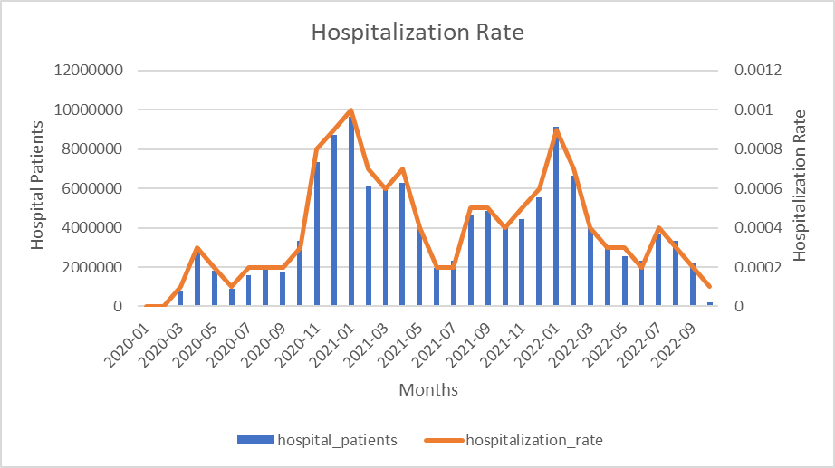
6.Hospitalization Rate
Hospitalization rate was all time high at 0.0004 in the
month of january - 2021

Slide 11
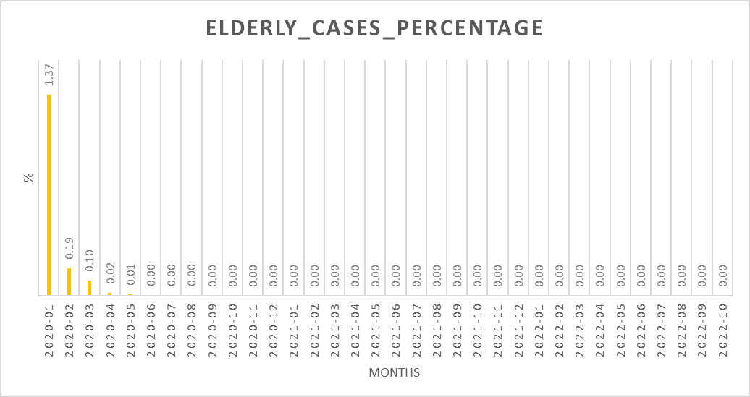
7. Percentage of COVID-19 Cases Among the Elderly Population
1.37% of cases were highest in january 2020

Slide 12
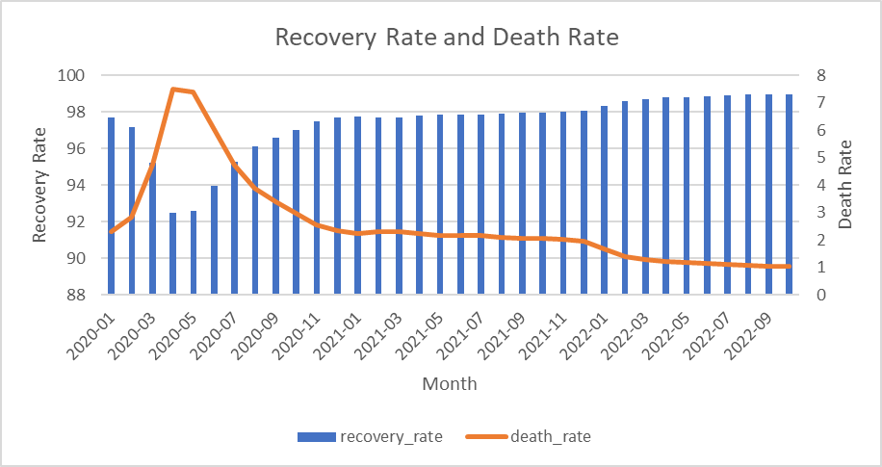
8.Recovery Rate and Death Rate
comparing both the rates, recovery rate (89867668495900)was the highest which shows that covid-19 was a deadly pandemic or vaccination were properly provided resulting in bigger recovery rate.

Slide 13
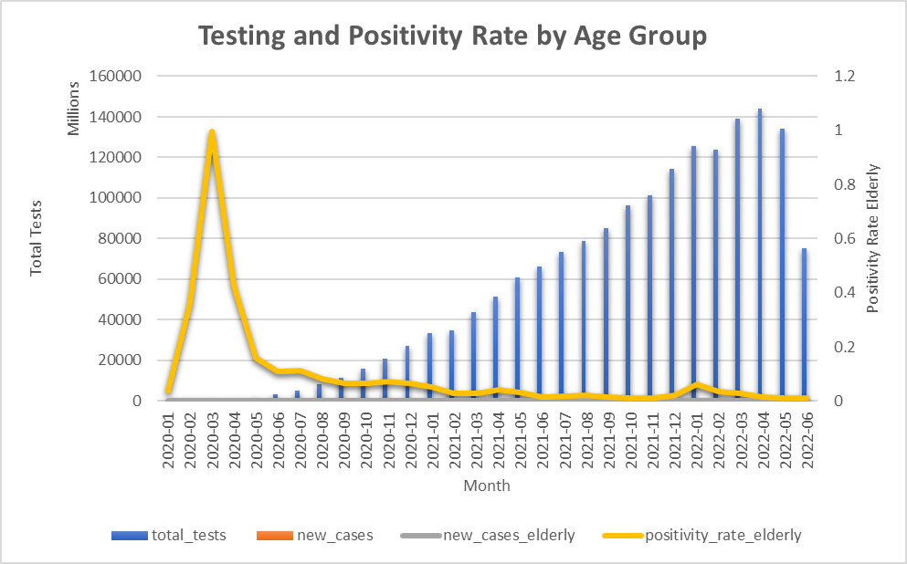
9.Testing and Positivity Rate by Age Group
The relationship between testing efforts and the positivity rate among the elderly population.
A higher positivity rate in the elderly group could indicate the need for targeted interventions.

Slide 14
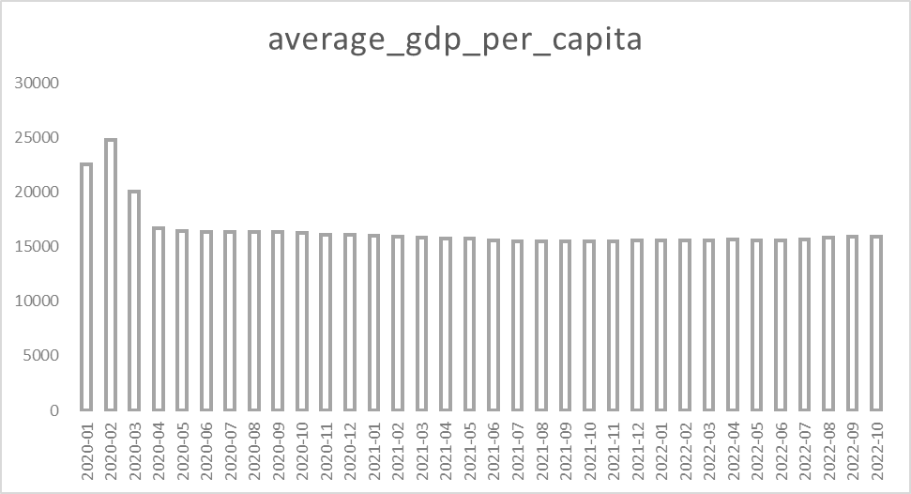
10. Impact on GDP
The Impact on GDP assesses how external factors, like COVID-19, affect a country's economic performance. It measures economic contractions, recoveries, and informs policy decisions for resilience during and after crises.

Slide 15
Thank You

